Slide 1
SAFHS Assessment
Oct. 7, 2020

Slide 2
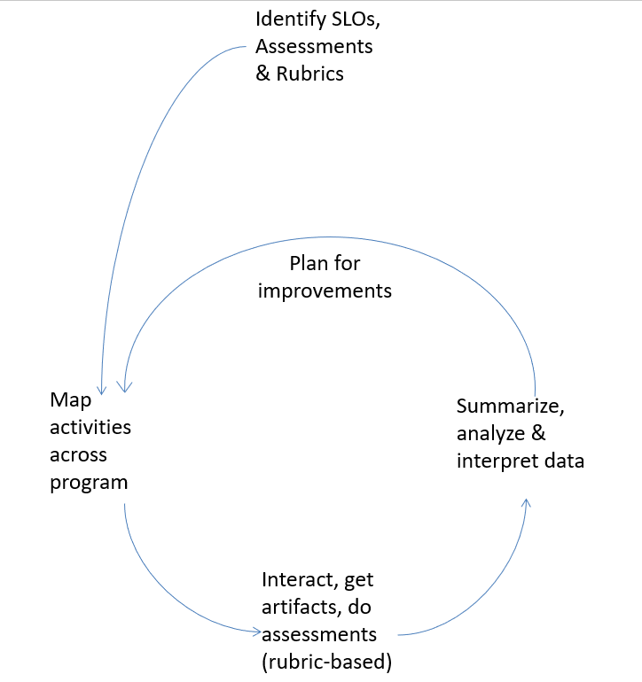
ASSESSMENT AND IMPROVEMENT: A Great Big 6
PLANS FOR IMPROVING OUTCOMES
What did assessment data show?
What will be done to improve outcomes?

Slide 3
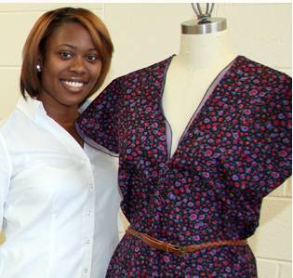
HuSC - Lifelong learning
“Faculty will adjust instruction to improve the lowest score, reflection, by integrating opportunities for students to have oral and written reflection time in and outside of the classroom…”

Slide 4
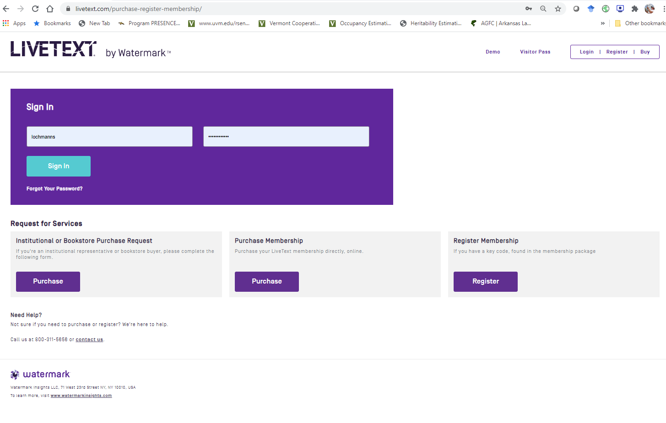

Slide 5
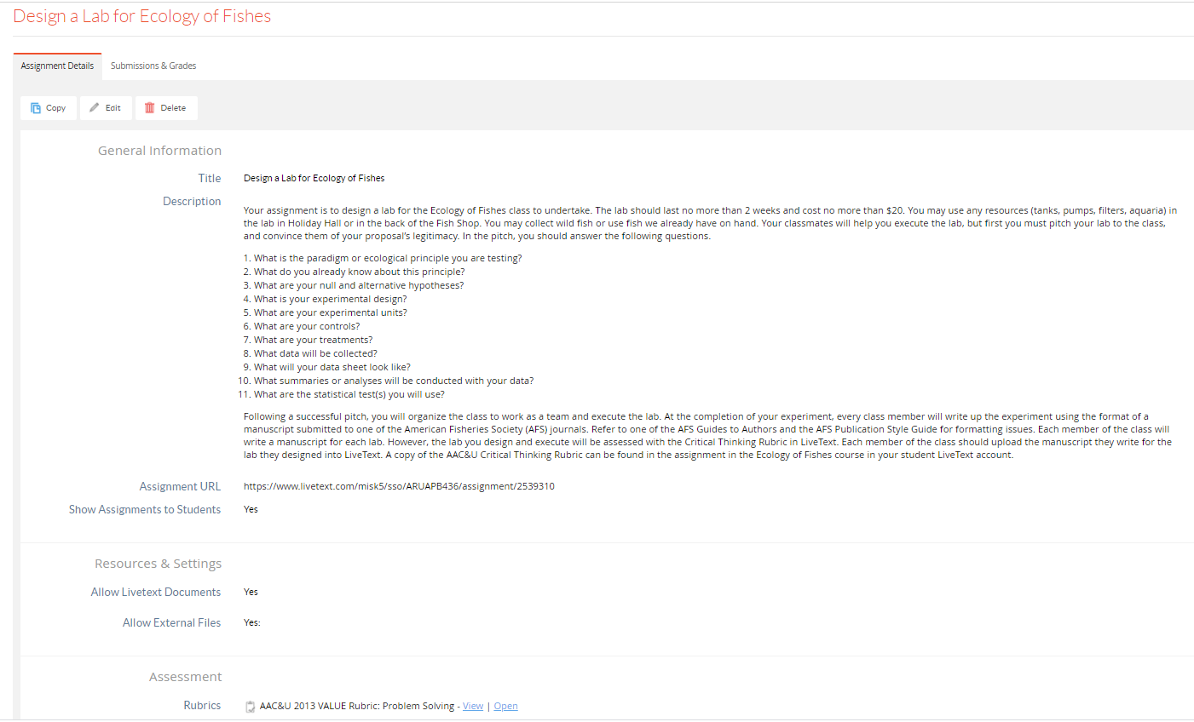

Slide 7
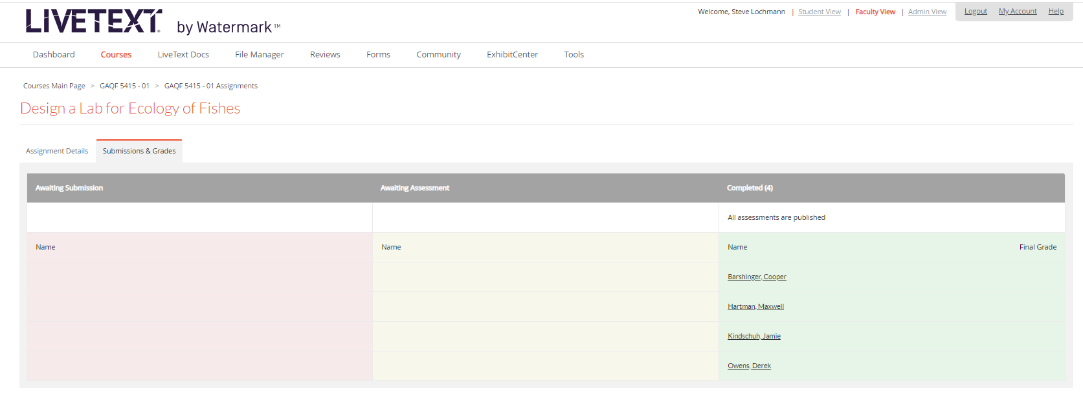

Slide 8
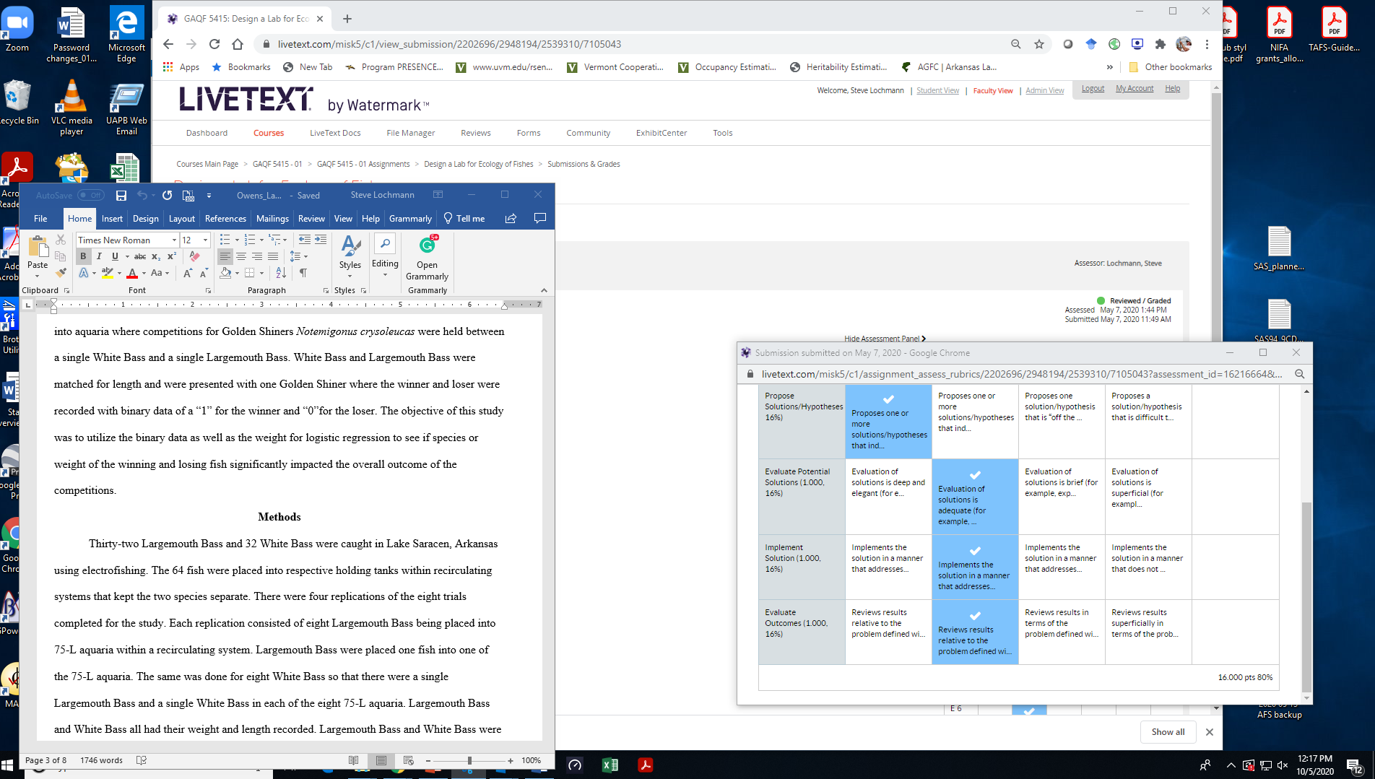

Slide 9
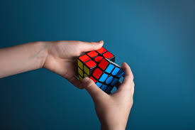
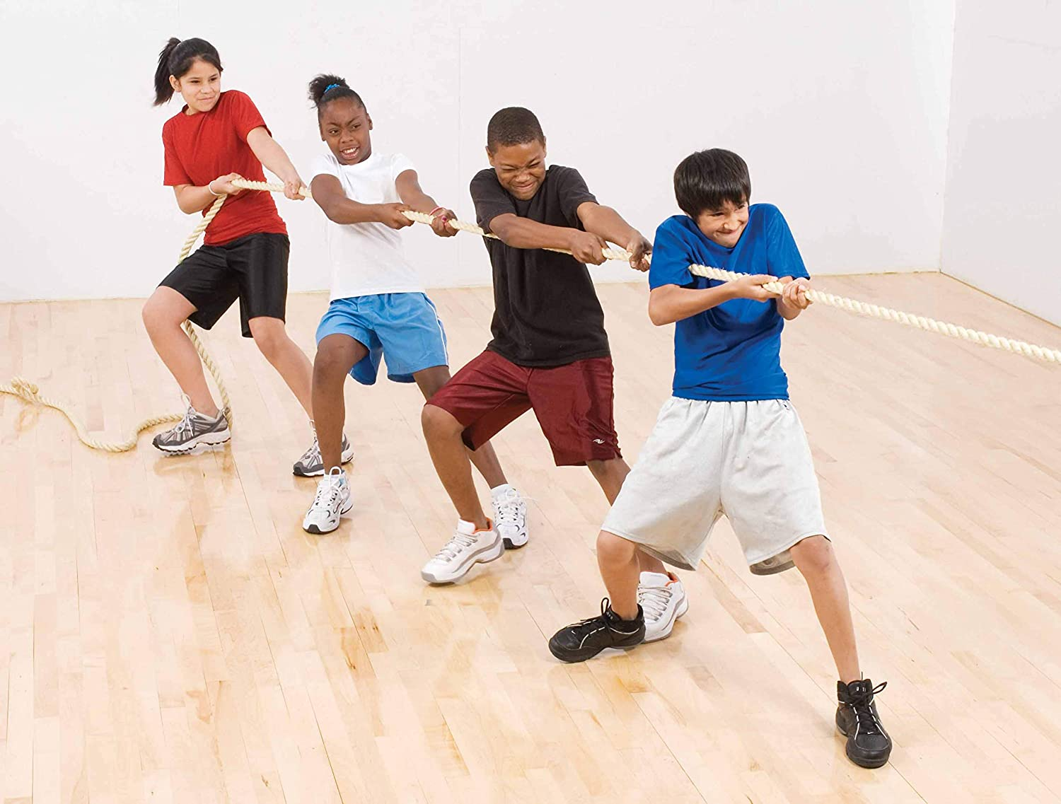
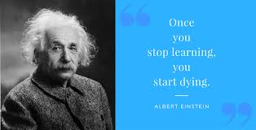
Institutional SLOs
Problem Solving
Teamwork
Lifelong Learning
Complete list at http://www.uapb.edu/administration/academic_affairs/assessment.aspx

Slide 10
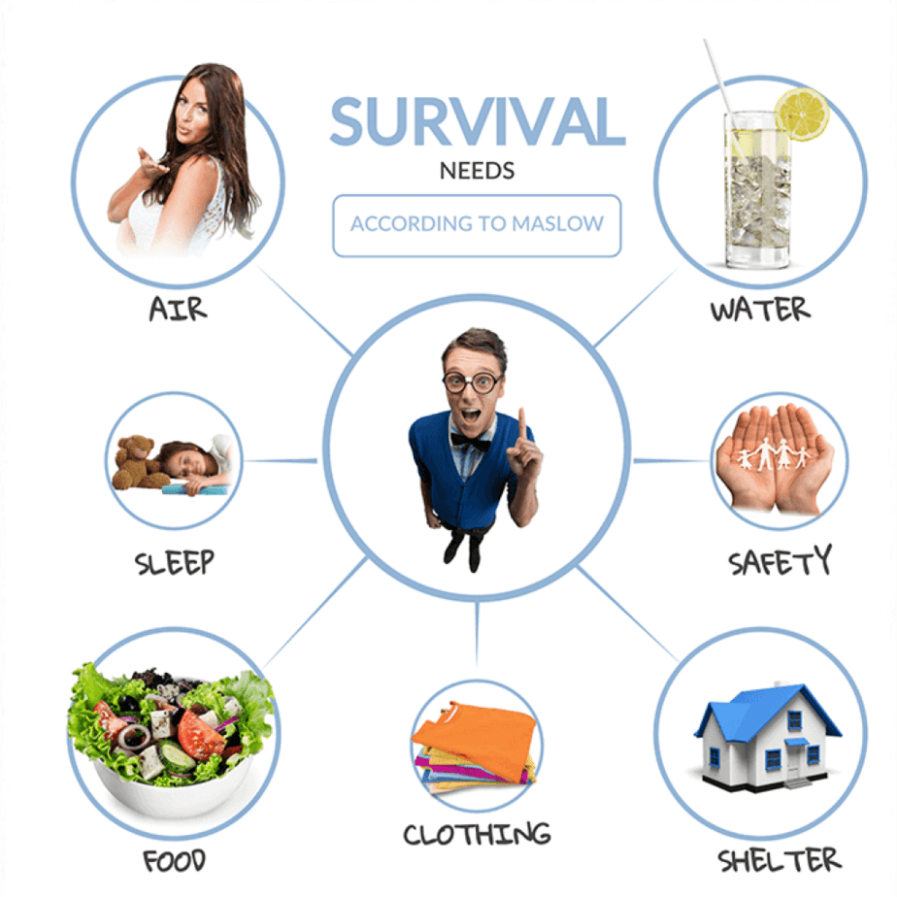
School SLOs
Global Learning
Human Needs and the Global Environment

Slide 11
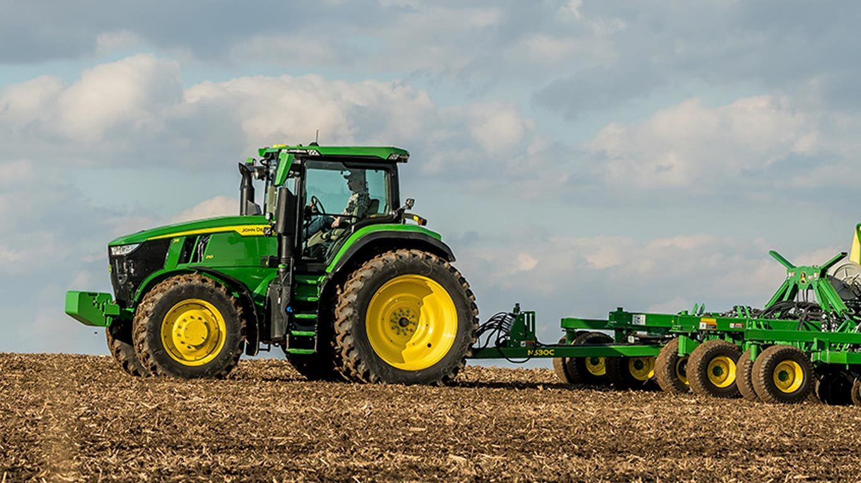
AGRI Degree Program SLOs
Ag Sci – Global agricultural production practices and processes
Reg Sci – Regulatory compliance associated with food, agricultural, industrial, health and environment safety
Ag Eng – new program

Slide 12
AQFI Degree Program SLOs
Aq & Fish Sci - Oral Communication

Slide 13
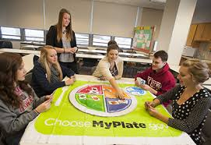
HUSC Degree Program SLOs
Hum Sci - To explain how their major impacts the lives of individuals families and community
Hosp Tour Mgmt – new program

Slide 14
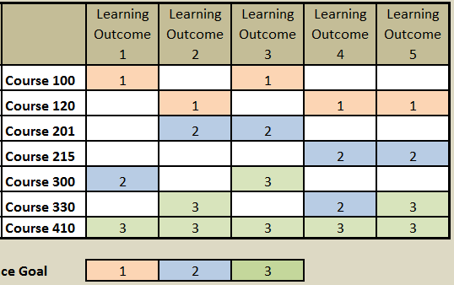
Curriculum maps
Matrix with Rows and Columns
Columns are SLOs
Rows are classes
Cells are Assignments (introduce, reinforce, assess mastery)

Slide 15
Example: AG Sci Curriculum map
Go to excel file of curriculum map…

Slide 16
Senior comprehensive exams
9/29/20 Memo from Provost
“Individual departments will decide how or if to administer the senior comprehensive examination this semester. After this semester, this examination will be revamped and included as part of a capstone course.”

Slide 17
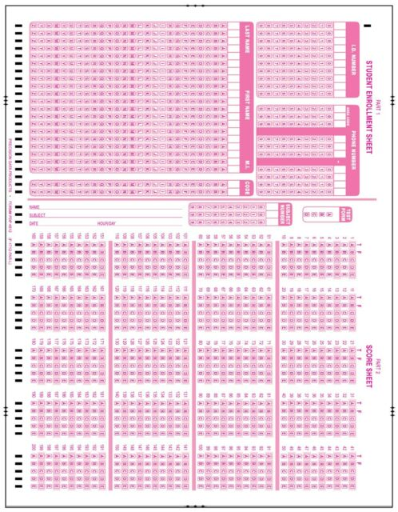
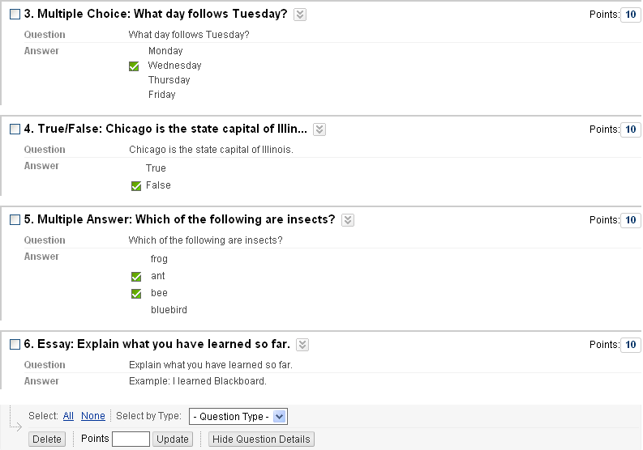
Senior comprehensive exams
Pencil & Paper Blackboard

Slide 18
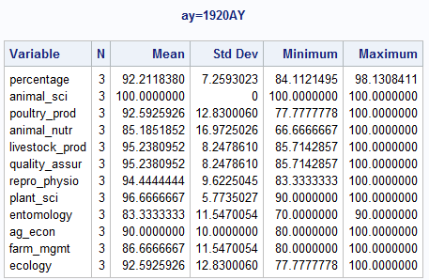
Assessment Analysis by knowledge area not possible with blackboard sen comp exam
HPER – SET UP SUBTESTS IN BLACKBOARD SO THEY CAN ANALYZE BY KNOWLEDGE AREA

Slide 19
Curriculum maps
Get ready for 2122AY
Written Communication, Reading
Global Learning, Human Needs and Global Environment
New Degree Program SLO

